Slide 1
Solar Neutrinos in SNO+
Jie Hu
Particle-astro Group Meeting
11 Dec, 2020

Slide 2
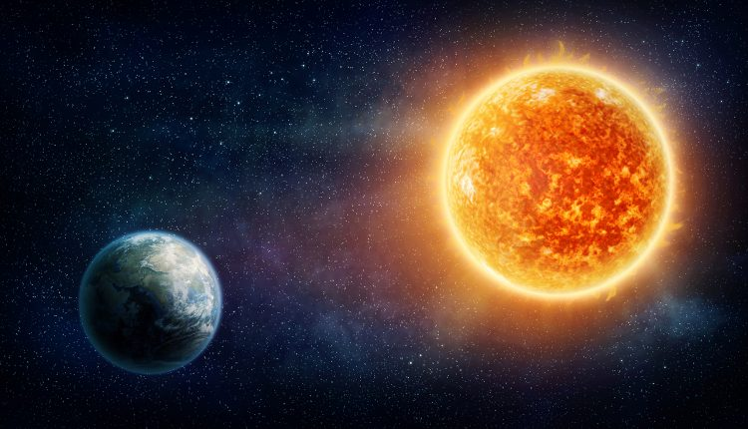
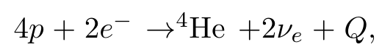
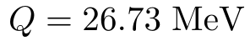
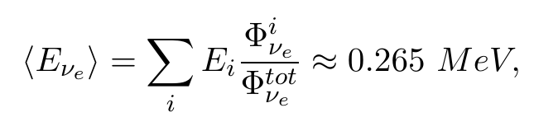
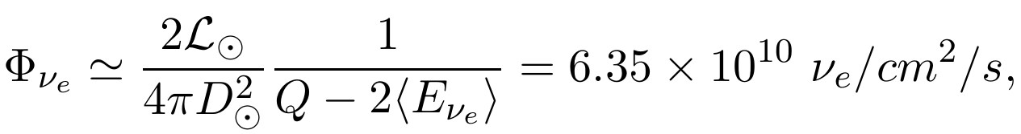
Solar Neutrinos
Electron neutrinos produced in the core of the Sun through various nuclear fusion reactions.
L⊙
ν_{e}
ν_{e}
ν_{x}
Net nuclear transformation: hydrogen are fused into heliums
D⊙
Average energy
Total flux reaches the Earth (luminosity relation)
where the solar constant:

Slide 3
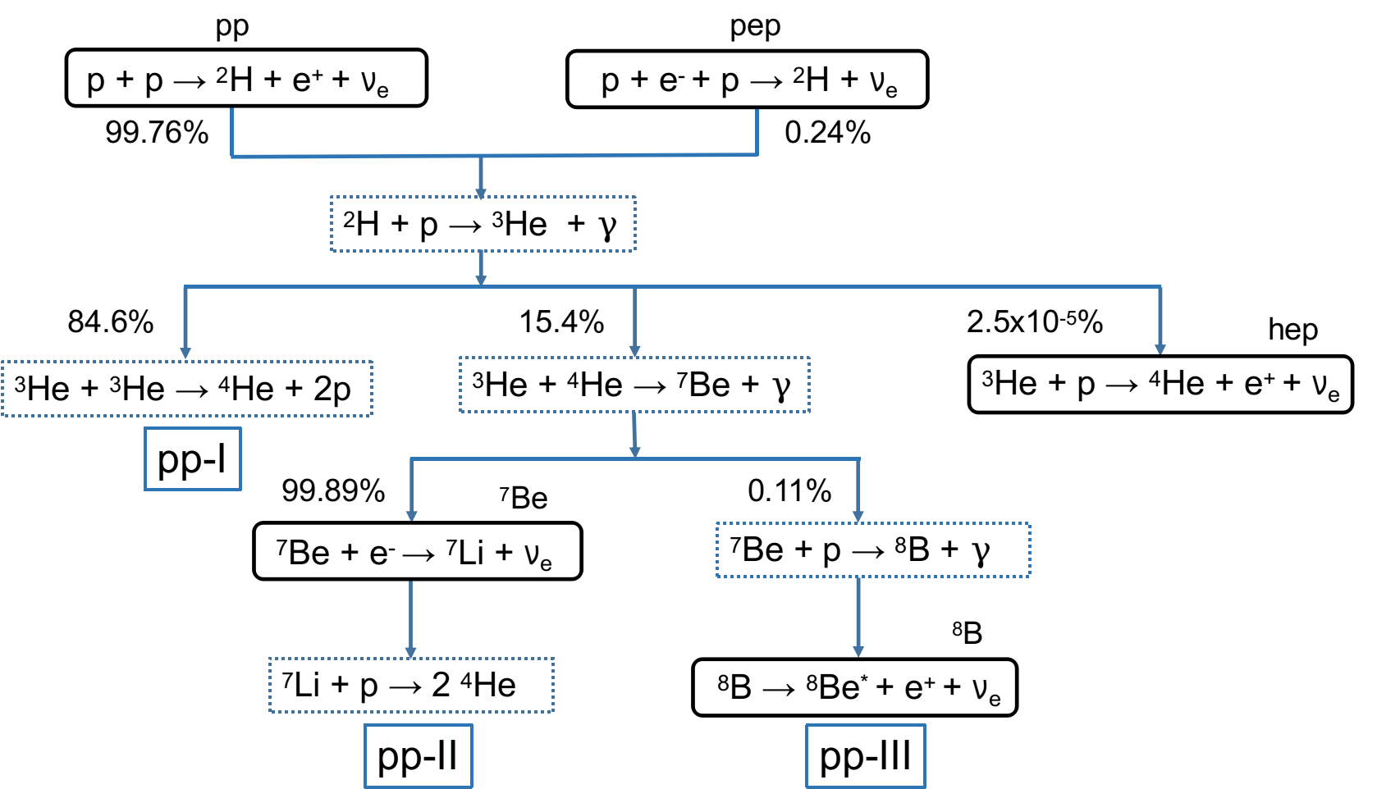
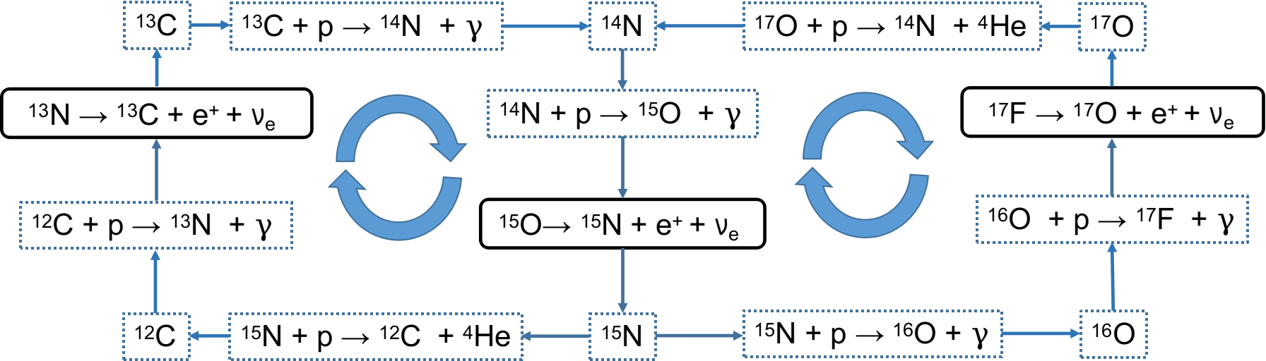
pp chain
~99%
CNO cycle
~1%
sub-cycle I
sub-cycle II

Slide 4
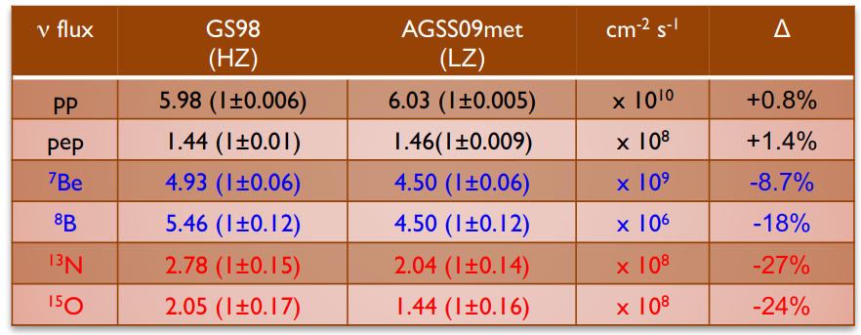
Why Measure Solar Neutrinos?
Test standard solar model (SSM)
SSM: a modern accepted theory for the evolution of the Sun described by several differential equations derived from basic physical principles, such as plasma, nuclear, astrophysics models.
A mathmetically calculated stellar structure with the best measurement parameters as inputs.
- Metallicity problem
Metallicity: the abundance of elements heavier than helium (Z/X)
Helioseismology: speed of sound measurement
Problem:
Helioseismology gives Z/X ~ 1.8% (high Z)
while the SSM gives Z/X ~ 1.3% (low Z)
Solar neutrino fluxes are sensitive to
the Sun metallicity.
from Borexino presentation: Davide D’Angelo, Borexino Latest Solar Neutrino Results

Slide 5
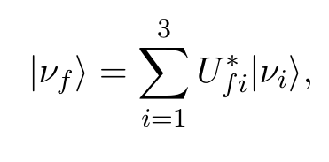
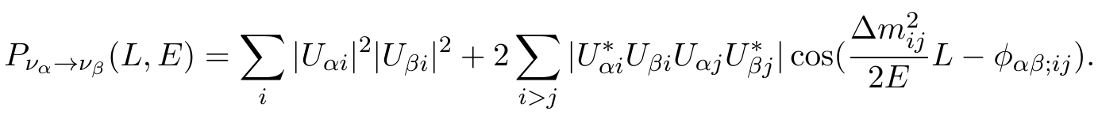
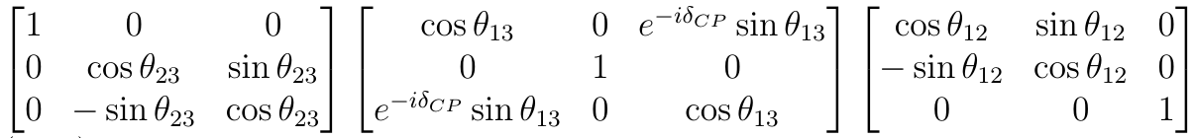
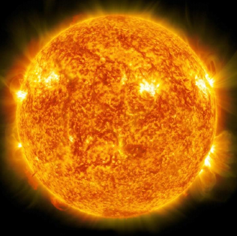
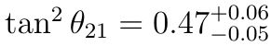
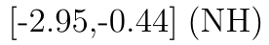
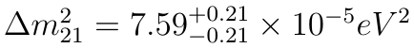
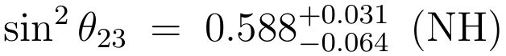
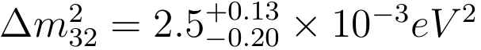
Why Measure Solar Neutrinos?
Investigate neutrino flavor transformation parameters
flavor transformation in lepton sector
flavor transformation probability
flavor eigentates
mass eigentates
U_{fi} =
KamLAND + SNO
T2K
Solar experiments
E_{ν} ~ O[MeV]
Δm² ~ O[10⁻⁵ eV²]
L ~ O[10¹⁰ m]
SuperK
Daya Bay

Slide 6
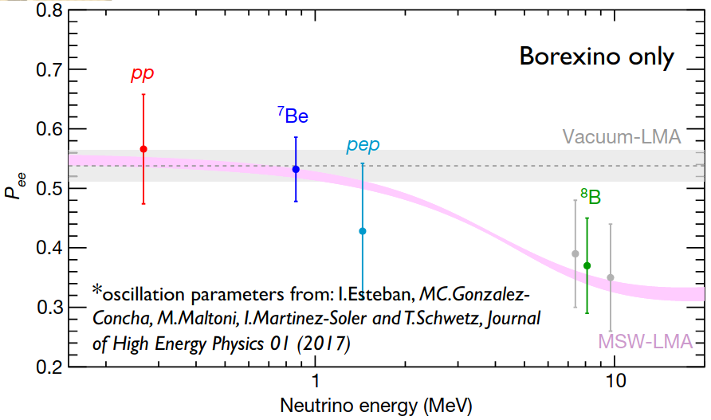
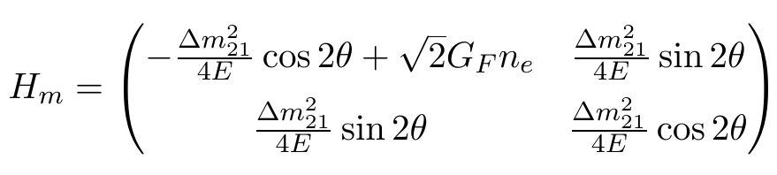
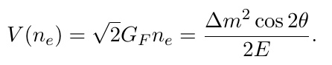
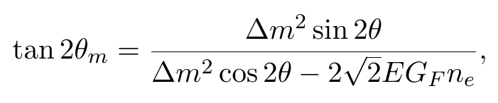
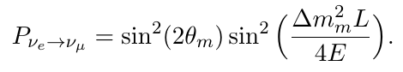
Why Measure Solar Neutrinos?
Investigate neutrino flavor transformation parameters
Mikheyev-Smirnov-Wolfenstein (MSW) mechanism
The flavor transformation of ν_{e} →ν_{x} is enhanced since an additional potental of ν_{e} interacting with ambient electrons and nucleons in matter via charged weak current.
matter effect
θ→θ_{m}
G_{F}: the Fermi coupling constant for the weak interaction
n_{e} : the number density of the electrons in matter
Resonance condition
from Borexino presentation: Davide D’Angelo, Borexino Latest Solar Neutrino Results
θ_{m}→ π/4,
The flavor transformation probability reaches maximum.

Slide 7
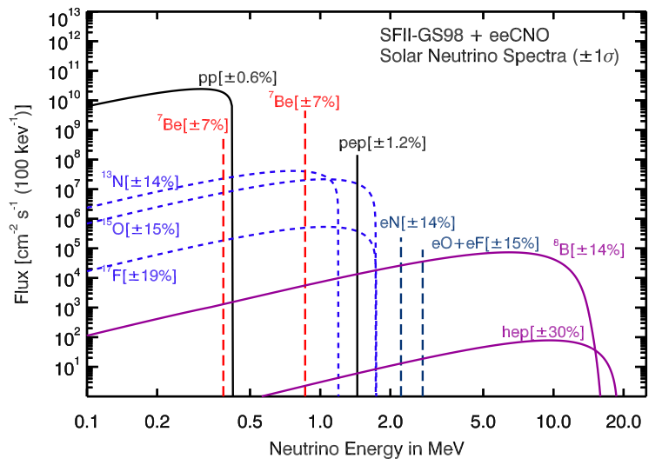
Solar Neutrino Flux
liquid scintillator detector E_{threshold}> 0.18 MeV
Some of the measured results
type | experiment | flux (cm⁻²s⁻¹)
⁸B | SNO (2013) | 5.25±0.16(stat.)^{+0.11}_{−0.13}(syst.) ×10⁶
 | SNO+ (2018) | 2.53^{+0.31}_{−0.28}(stat.)^{+0.13}_{-0.10}(syst.) ×10⁶ without oscillations
 | Borexino (2016) | 2.55 ±0.18 ±0.07 x 10⁶ without oscillations
⁷Be | KamLAND (2015) | 5.82 ±1.02 x 10⁹
 | Borexino (2018) | 4.99 ± 0.13(stat.)^{+0.07}_{-0.10}(syst.) x 10⁹
pp | Borexino (2018) | 6.1 ± 0.5(stat.)^{+0.3}_{-0.5}(syst.) x10¹⁰
CNO | Borexino (2020) | 7.0^{+3.0}_{-2.0} x 10⁸
water Cherenkov detector
E_{threshold} > 3 MeV
pdg 2018

Slide 8
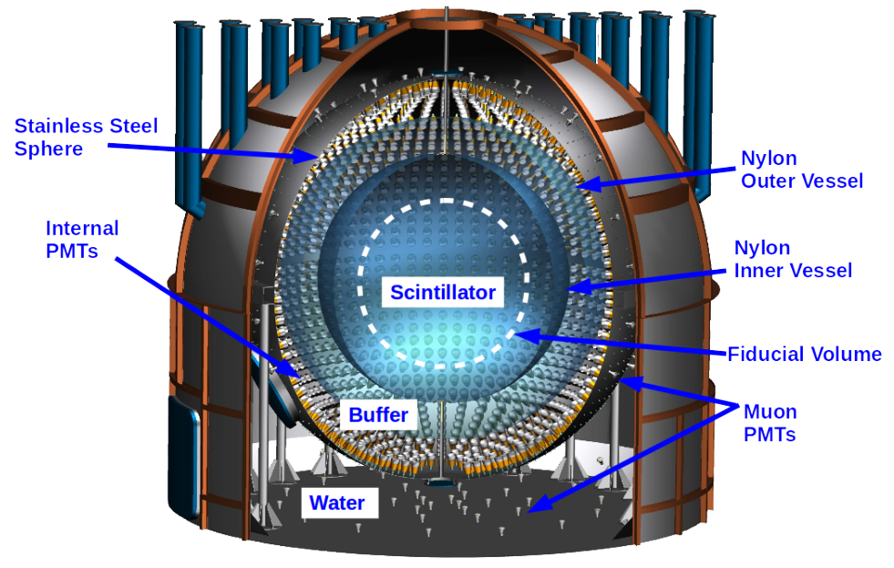
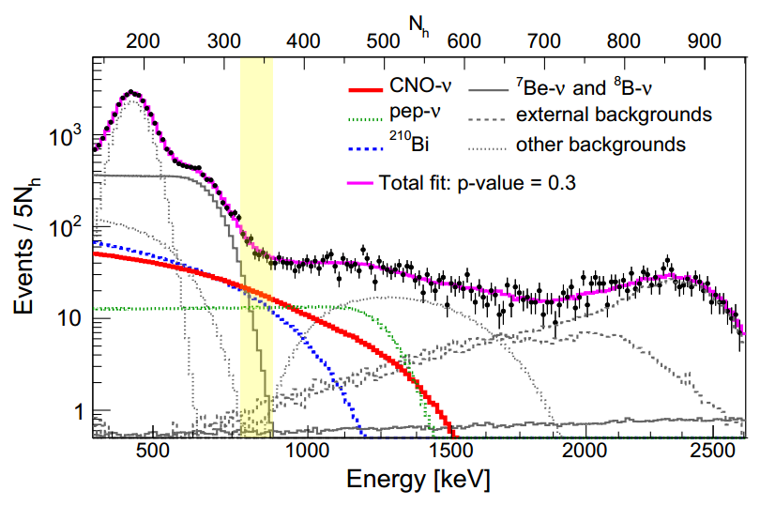
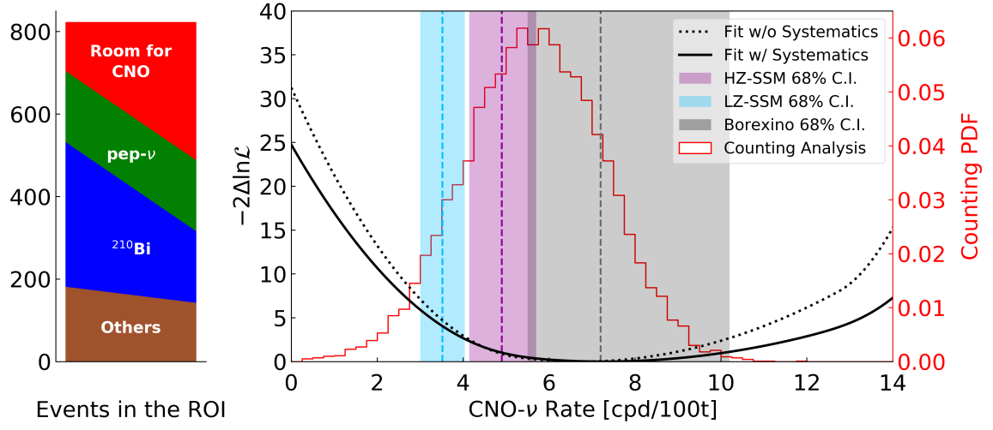
CNO Neutrinos
First detection of CNO neutrinos by the Borexino Experiment.
Borexino: an acrylic detector using liquid scintillator in Laboratori Nazionali del Gran Sasso, Italy.
Reported Results in 2020
The absence of CNO signal is disfavored at 5σ
CNO ν interaction rate is 7.2^{+3.0} _{-1.7} counts/day/100 tonnes of target at 68% C.L..
Estimated flux is 7.0^{+3.0}_{-2.0} x 10⁸ cm⁻²s⁻¹
Borexino Collaboration. "Experimental evidence of neutrinos produced in the CNO fusion cycle in the Sun." Nature 587.7835 (2020): 577-582.,

Slide 9
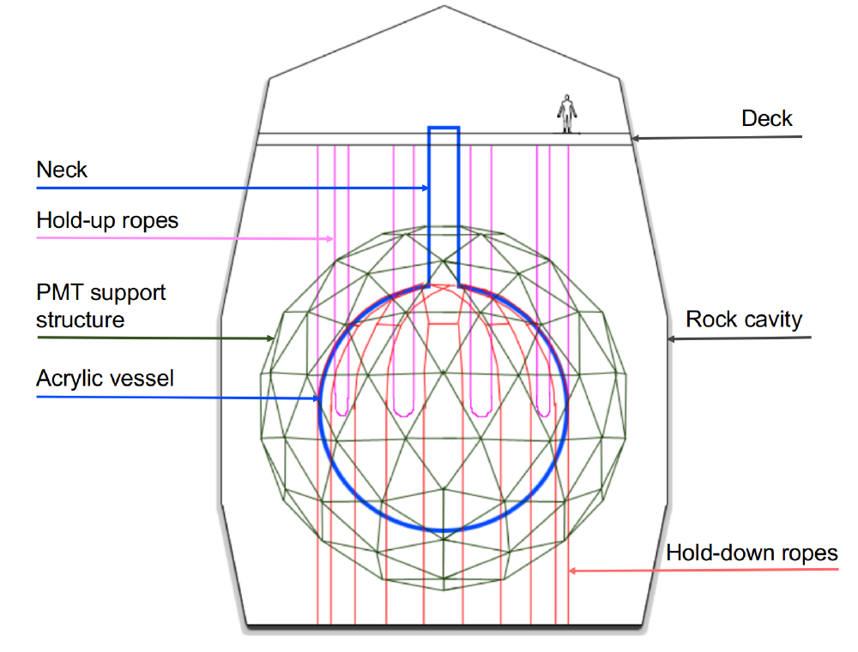
SNO+ Physics Phases
The SNO+ Experiment
Successor of the SNO experiment.
Located 2070 m below surface, a depth of approximately 6000 m water equivalent.
12 m diameter, 5.5 cm-thick acrylic vessel (AV).
9438 photomultiplier tubes (PMTs) supported by a 18 m diameter geodesic structure.
Cavity filled with 7 kilotons of ultrapure water.

Slide 10

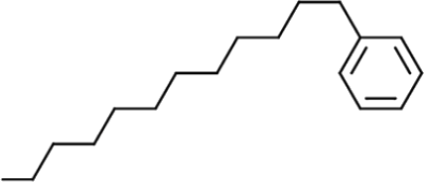
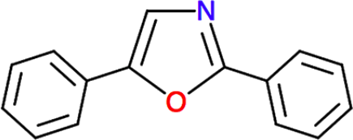
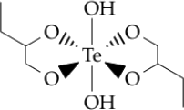
SNO+ Physics Phases
LAB
LAB
PPO
TeBD complex
PPO
Water Phase
Filled with 905-ton ultrapure water.
Measurements have been made for: nucleon decay, solar neutrinos.
Partial-fill Phase
Currently filling.
Scheduled periodic pauses at a certain water level for background studies.
Scintillator Phase
Filled with 780-ton
LAB-PPO.
Goals: Measure reactor antineutrinos, geo-neutrinos and solar neutrinos.
Te-loading Phase
Loading 0.5% natrual Te by weight into the
scintillator.
Goals: Search for neutrinoless double beta decay.
May 2017-Oct 2018
Current
Early 2021
Late 2021

Slide 11

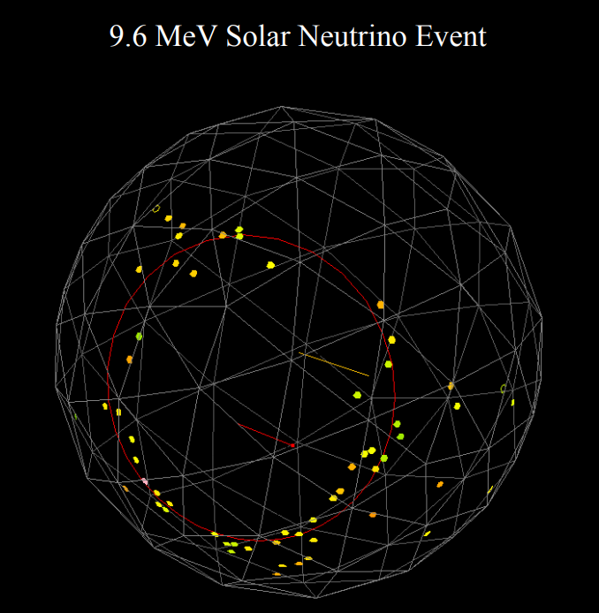
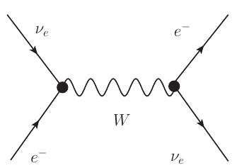
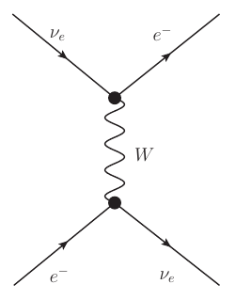
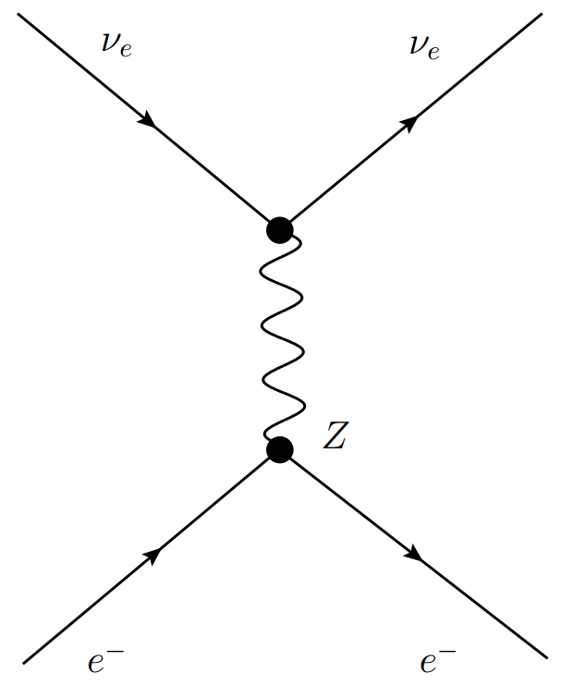
Solar Neutrino Detection in SNO+ Water Phase
PMT Support Structure
elastic scattering
A 9.6 MeV solar neutrino event
ν
ν_{e} + e⁻ → ν_{e} + e⁻
ν_{x} + e⁻ → ν_{x} + e⁻
photons
e⁻
An event is recorded every time when enough PMTs are triggered.
Hit time and charge are then recorded.
From Eric Marzec (on behalf of the SNO+ Collaboration), APS April Meeting 2019

Slide 12
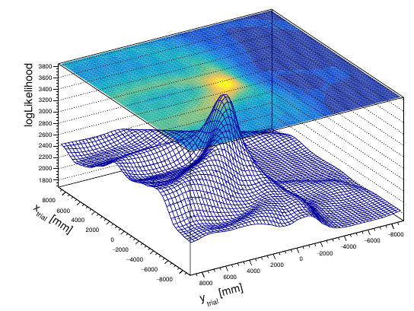
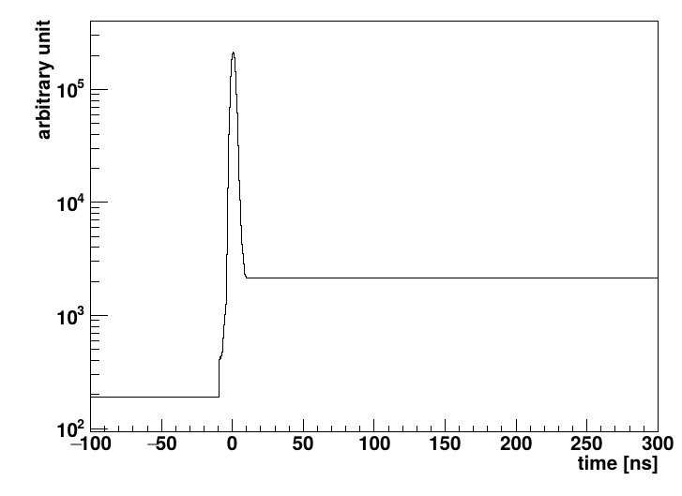
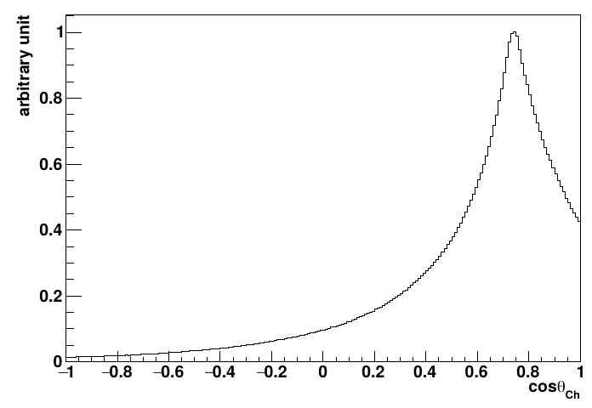
Reconstruction Method
Vertex reconstruction
Evaluating the light paths from the trial vertex to the triggered PMTs; to calculate and fit with the timing
response of triggered PMTs.
θ_{ch}
event
event
light path
PMT timing
response
Direcion reconstruction
Evaluating the angles between
the trial event direction and
the direction pointing from the vertex
to the triggered PMTs; to fit this angle to the distribution extracted from simulations.
Simulated
Cherenkov
distribution
cosθ_{ch}

Slide 13
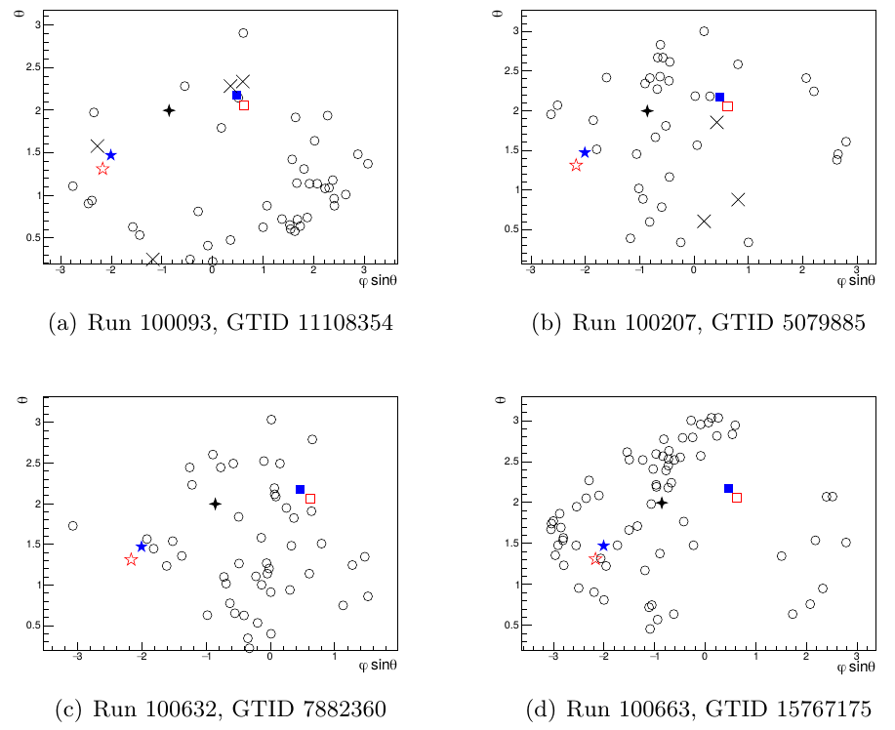
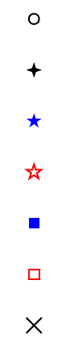
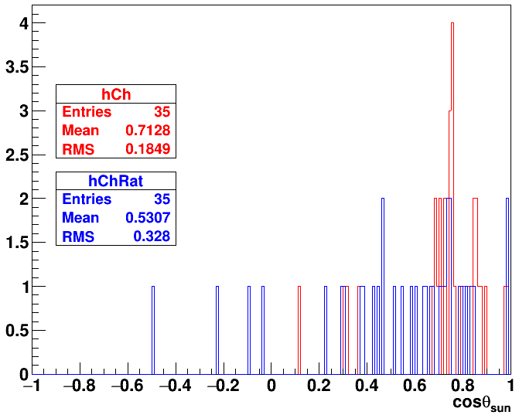
Why Do This Work?
The SNO+ water phase has an official reconstruciton algorithm.
Another reconstruction algorithm can input more information of the candidate events for physics analysis.
Monte Carlo (MC) simulations, mostly the optical models, have been improved since the first publication.
The reconstruction is updated for the MC updates.
New low background dataset with cover gas in the neck.
PMT
-1* sun direction
event direction, official
event direction, this work
event position, official
event position, this work
PMTs removed by cleanning cuts
PMT map of candidate solar events
(X_{PMT} - X_{fit})*u_{fit}
run 100207,
5079885
this work
official
candidate event is
disfavored by this work

Slide 14
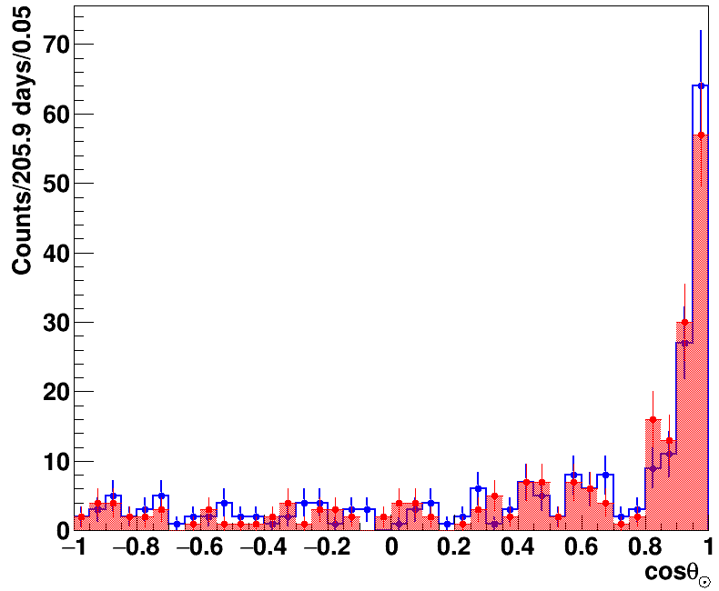
Select the Solar Neutrinos from Data
Mostly checking the direction of an event to see whether it comes from the Sun.
ν
This work
Official reconstruction
u
event
θ
Less events in the main
signal region of [0.9,1].
Less events in the flat
background regions.
Needs systematics to be added.
A few analysis cuts:
- energy > 5 MeV to get rig of a large amount of backgrounds.
- fiducial volume cut (FV<5.3 m) to reduce external
backgrounds.
- position scale*direction to remove out-going events
- PMT timing window cuts to remove instrumental noises
- parameters evaluating isotropy to remove isotropic backgrounds
5.0<E<15.0 MeV

Slide 15
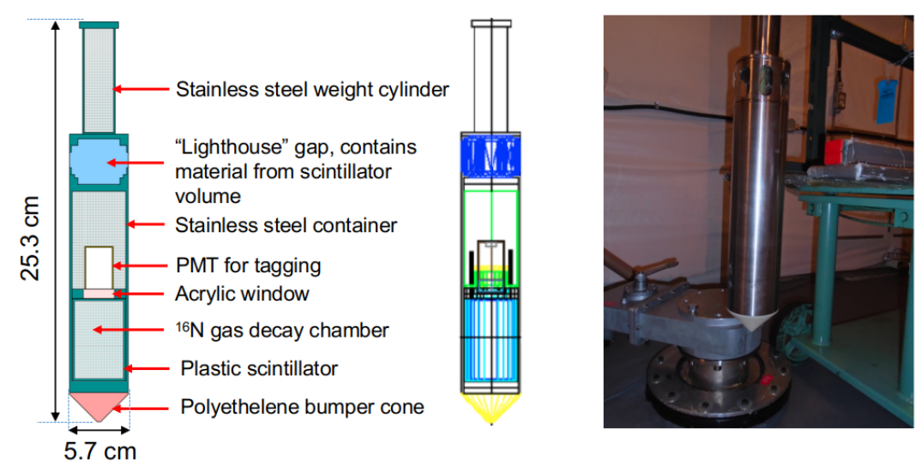
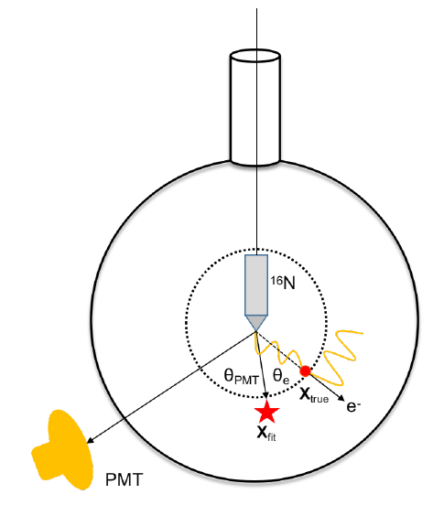
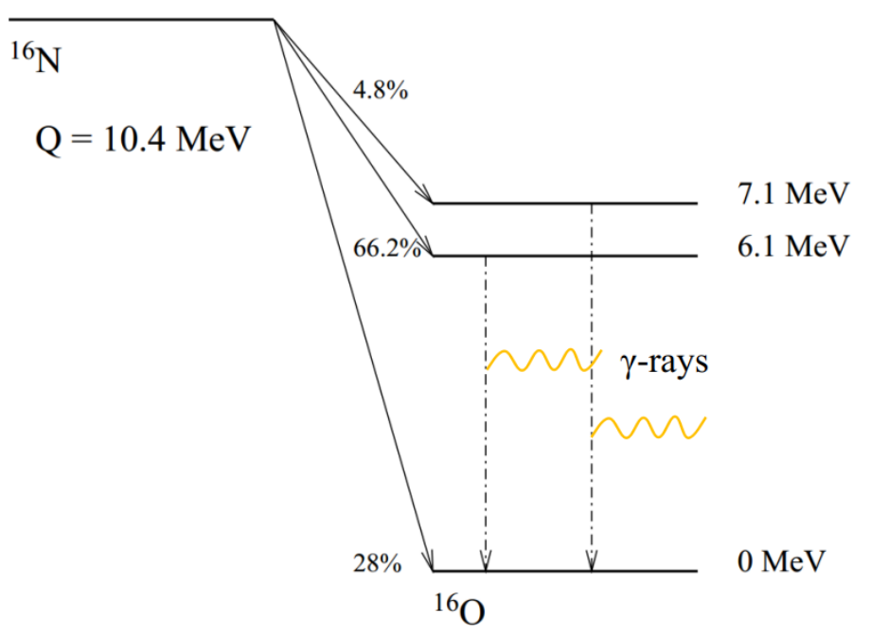
¹⁶N Calibration Source
For evaluating the biases between data and simulation, as well as the reconstruction uncertainties.
Multiple calibration runs have been deployed in water phase and partial-fill phase.

Slide 16
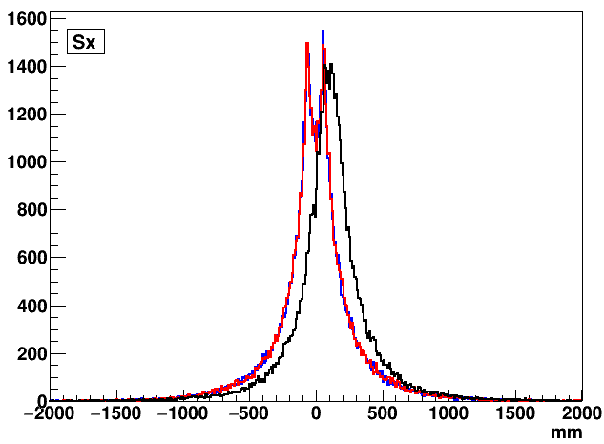
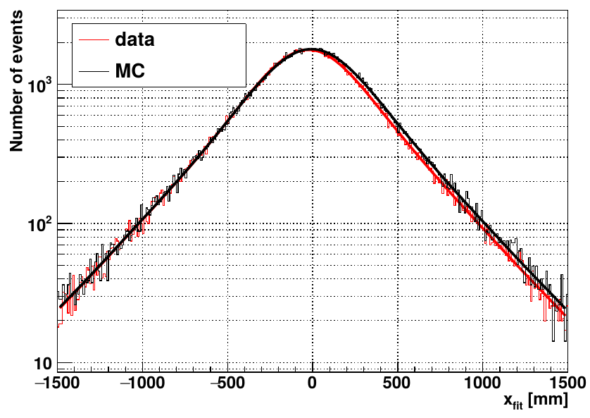
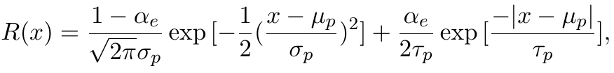
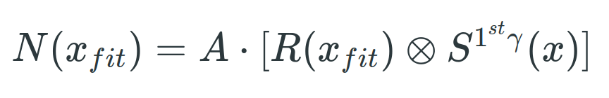
Position Reconstruction Resolutions
S^{1st-γ}(x): 1st γ interactions with water (from MC)
¹⁶N central run-107055 at (-5.283,-0.209,-1.057) mm
— x
— y
— z
To obtain: (1) fit bias μ_{P}; (2) fit resolution: σ_{P}

Slide 17
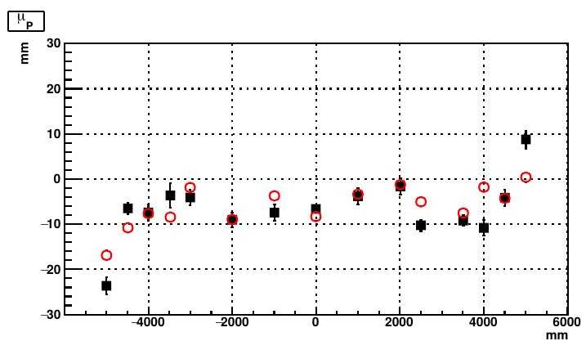
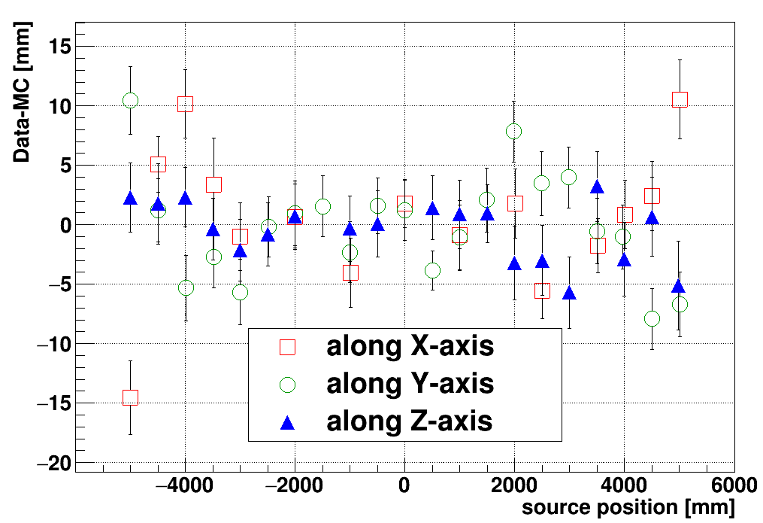




¹⁶N Scan Results
position biases/vertex shifts: μ_{P}(data)-μ_{P}(simluation)
Data
simluation
X scan
Y scan
this work
official pushlished paper
Z scan

Slide 18





¹⁶N Scan Results
position resolutions
X scan
Data
simluation
Y scan
Z scan

Slide 19



Direction Reconstruction Resolutions
Data
MC
α_{M} : fraction of
β_{M} : slope of the main peak due to the true angular resolution of the detector
β_{S} : slope of the tails due to electron multiple scattering

Slide 20


¹⁶N Scan Results
angular resolutions between data and simulation
β_{M} data/MC discrepancy: -5.7+-3.4 %
official: -6.9+-11.6%

Slide 21




Evaluate energy systematics: equivalent electron energy
A map of various simulated electrons energies
vs. Cherenkov photons produced by them.
Number of Cherenkov photons caused by ¹⁶N
γ-ray interactions.
SNO
results
full width at half maximum (FWHM)
~ 1.8 MeV
FHWM
~ 1.9 MeV
0.01 MeV per bin

Slide 22




Energy Reconstruction Resolutions
E_{fit} in ¹⁶N
Equivalent electron
distribution extracted
from the MC.
energy scale
detector resolution
Data
simulation
Data
convolution fit
χ²/ndf = 16.42/13 = 1.26
b = 0.376+-0.014
δ_{E} = 0.023+-0.004
run-107055 (-5.283,-0.209,-1.057) mm

Slide 23


¹⁶N Scan Results
Data
Simulation
Energy resolution
Energy resolution
b
b
Data/MC discrepancy: |b_{data} - b_{MC}|/b_{MC}*100% = 0.60%
Official: 0.75%

Slide 24




¹⁶N Scan Results
Data
Energy scale
Simulation
Energy scale
δ_{E} (x100%)
δ_{E} (x100%)
Data/MC averaged discrepancy:
= 0.863%
Official: 0.83 %

Slide 25


Further Studies
Possibility for going to lower energy thresholds and larger fiducial volumes
Utilizing the Toolkit for Multivariate Data Analysis with ROOT (TMVA) for separating data and background
based on simulations.
Utilizing the multiple variable analysis.
Mixing the signals with backgrounds, trainning on a few simulation dataset with different cuts applied.
Can we gain something from the partial-fill data?
Current filling level: ~700 mm above the AV center.
Lower background levels for the liquid scintillator.
It is possible to extract Cherenkov lights for providing the event direction information.

